Slide 1
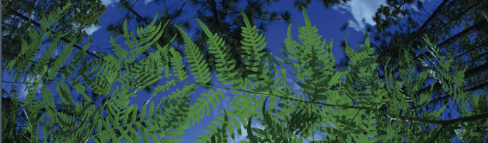



Data Downloads: Overview and Portals
Makenzie Mabry
Pam Soltis
University of Florida
BiotaPhy

Slide 2
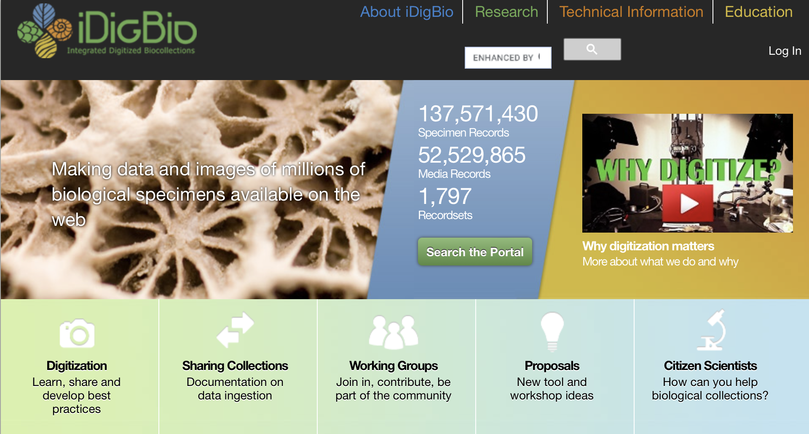
iDigBio: A Source for Specimen Records

Slide 3
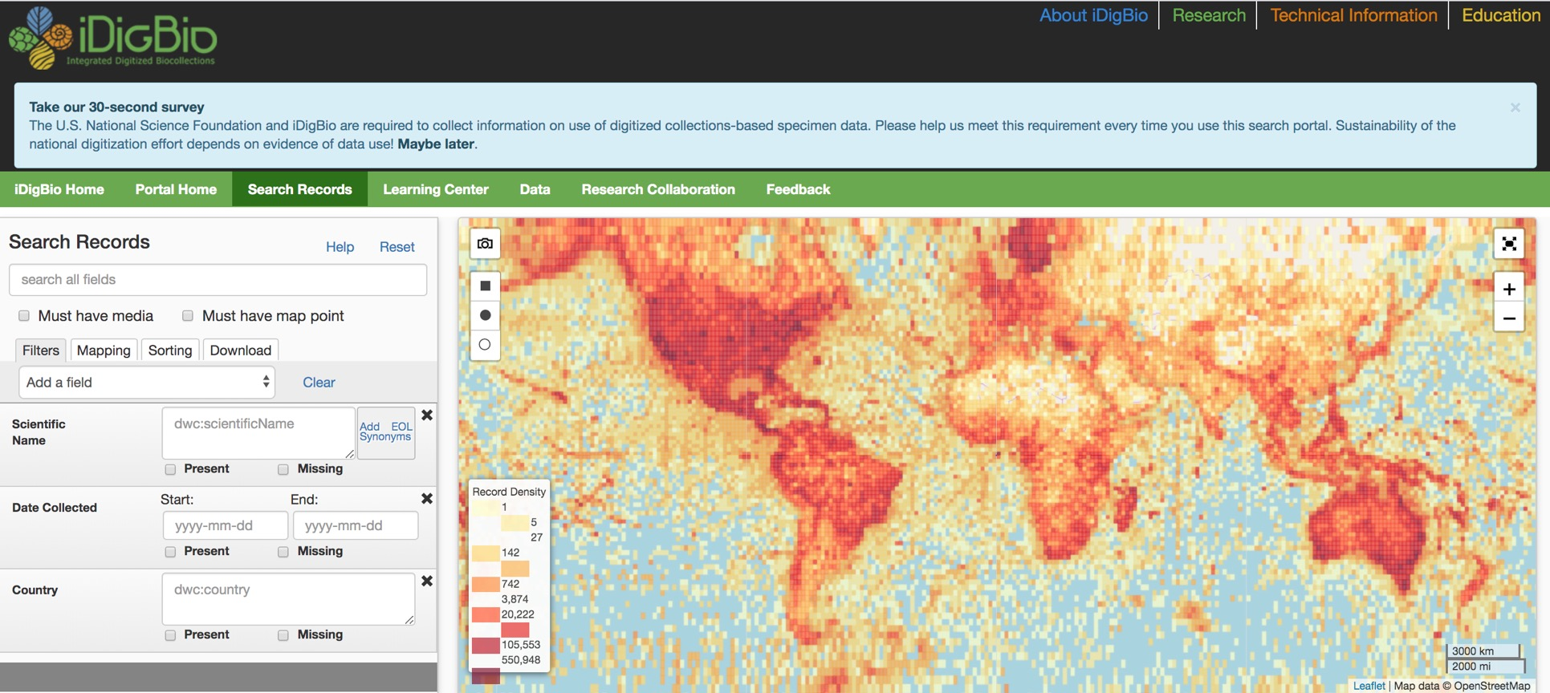
Search the iDigBio Portal

Slide 4
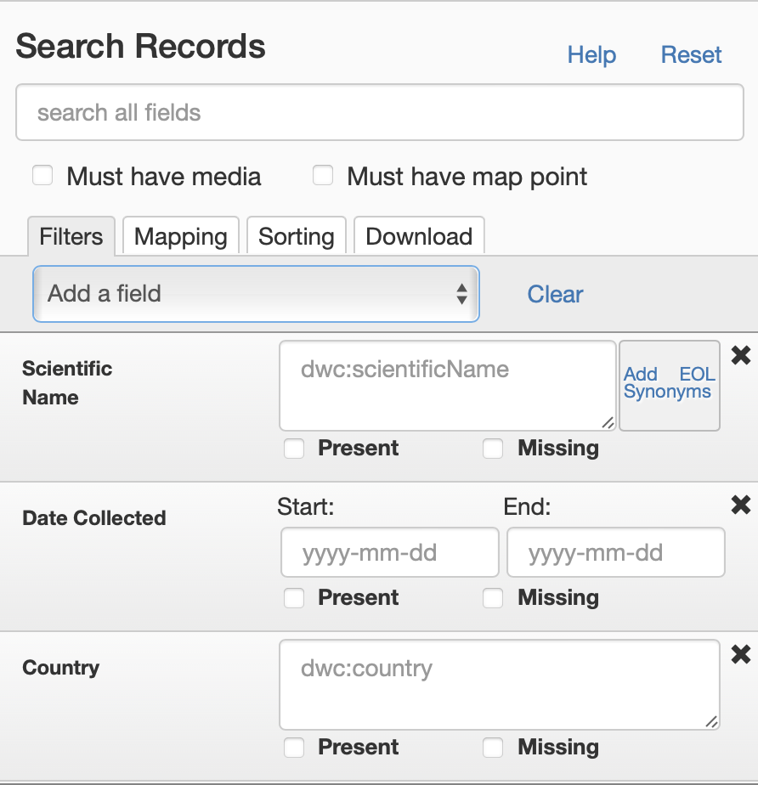
Search the iDigBio Portal – Specify Search Criteria

Slide 5
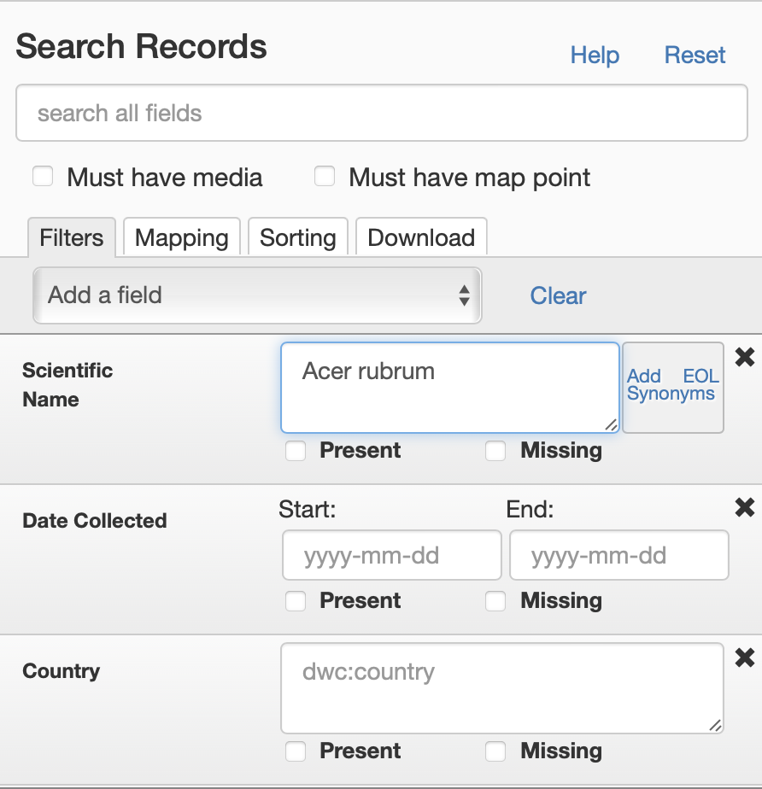
Search the iDigBio Portal – Specify Search Criteria

Slide 6
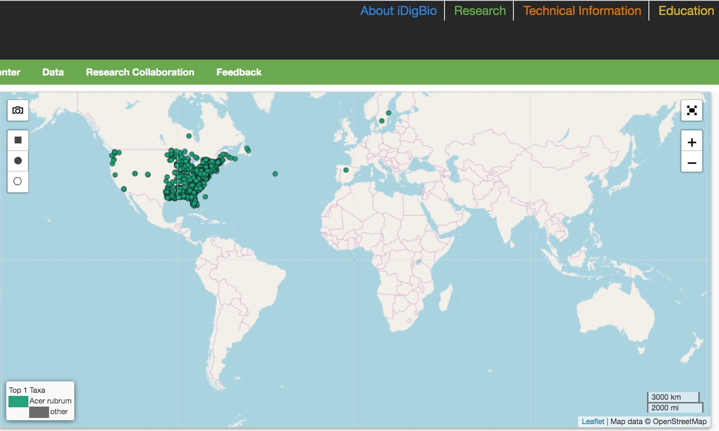
Search the iDigBio Portal – Results

Slide 7
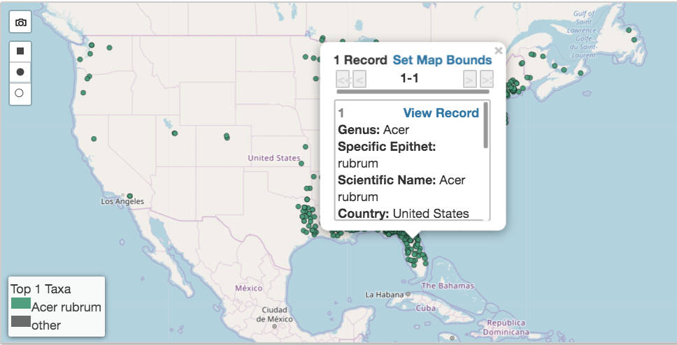
Search the iDigBio Portal – Record Summary

Slide 8
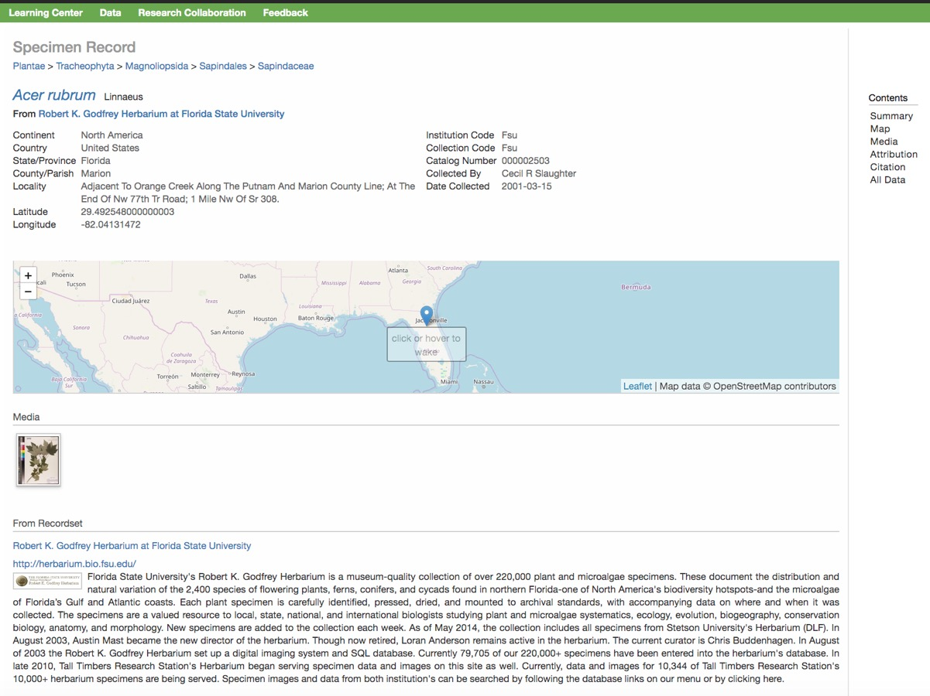
Search the iDigBio Portal – Specimen Record

Slide 9
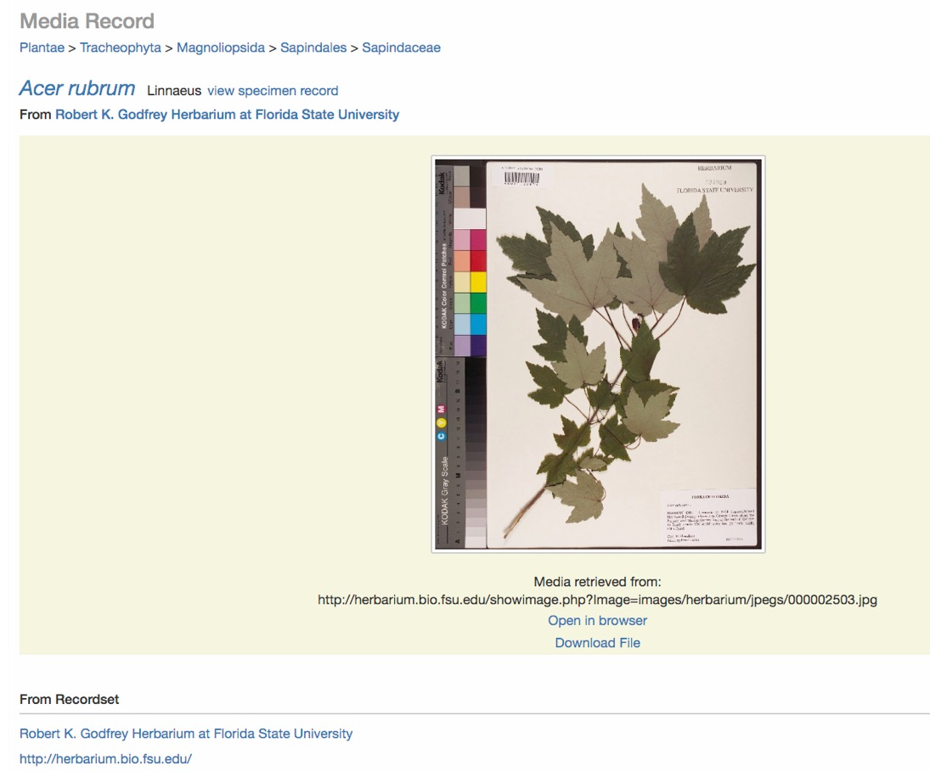
Search the iDigBio Portal – Link to Media Record (Image)

Slide 10
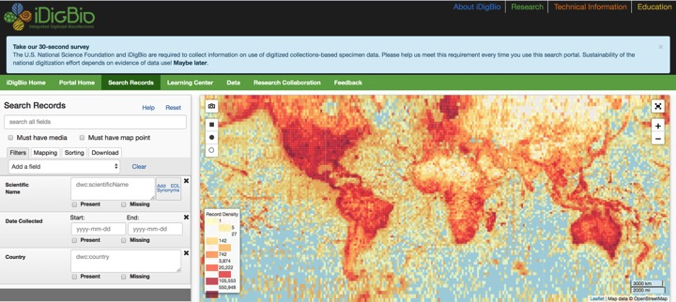
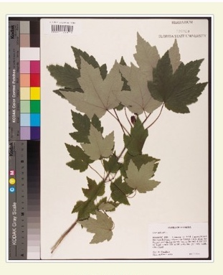
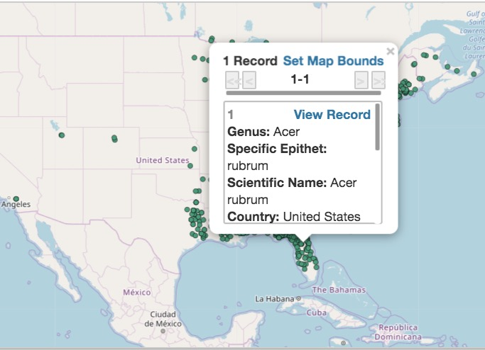
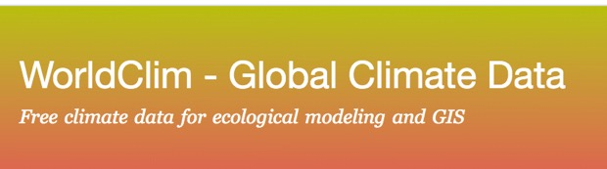
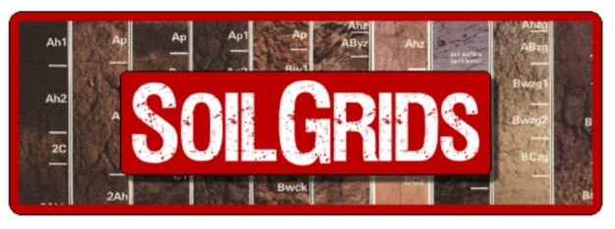
Each Location has associated Ecological Information
Temperature
Precipitation
Soil type
Soil Chemistry
Notes:
As we have seen, each specimen carries valuable information. For example, this specimen of red maple is from this locality in north central Florida. It represents a single location on a map – and if we use other databases, we can gain information about the ecology of that site – the temperature at the site, the precipitation, the soil type, soil chemistry, and perhaps more. So although all of this information isn’t found on the specimen label itself, the label helps us place the specimen on the map and then derive this other information.

Slide 11
Search the iDigBio Portal

Slide 12
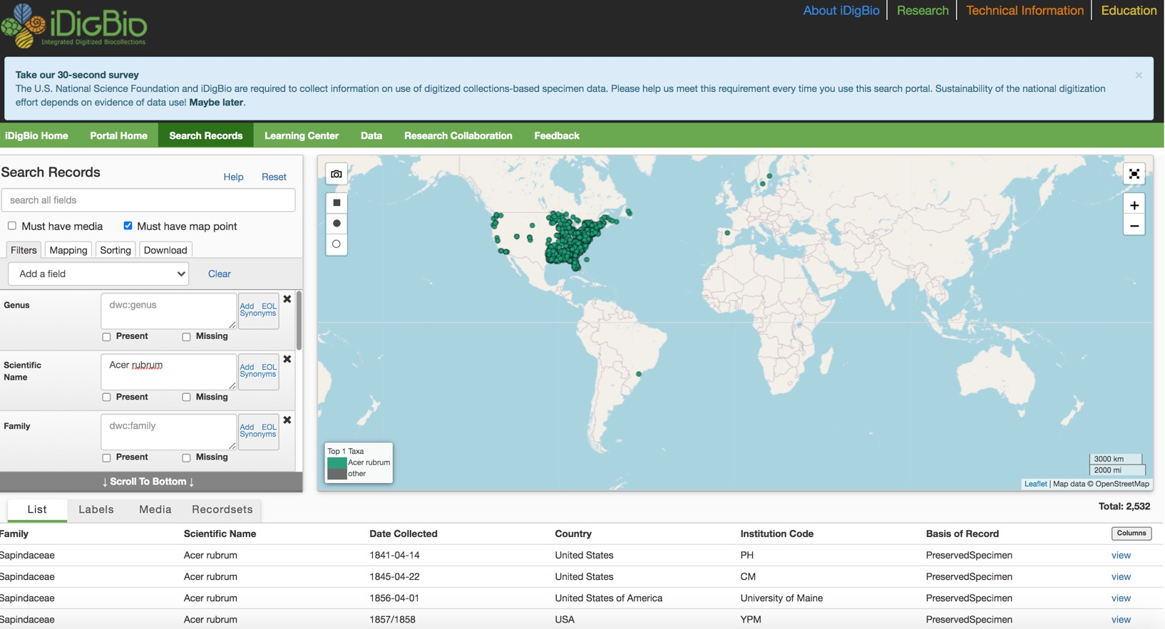
Search the iDigBio Portal: List of Data Records

Slide 13
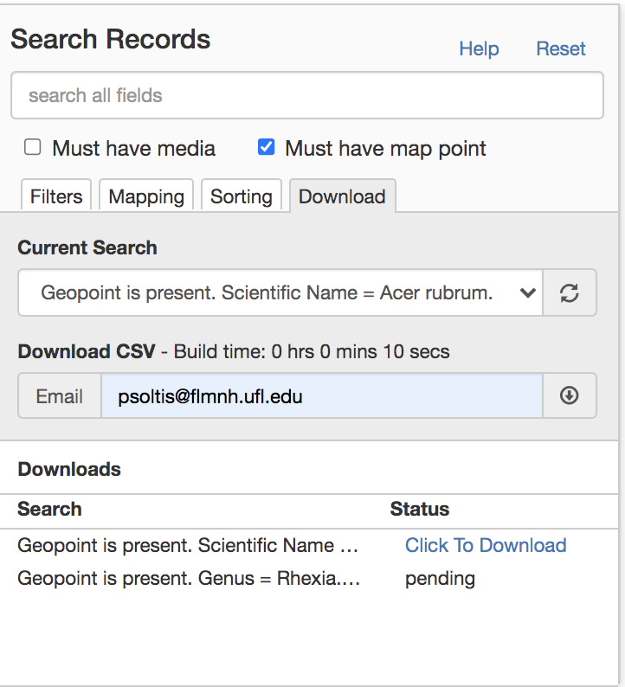
Search the iDigBio Portal: Download csv

Slide 14
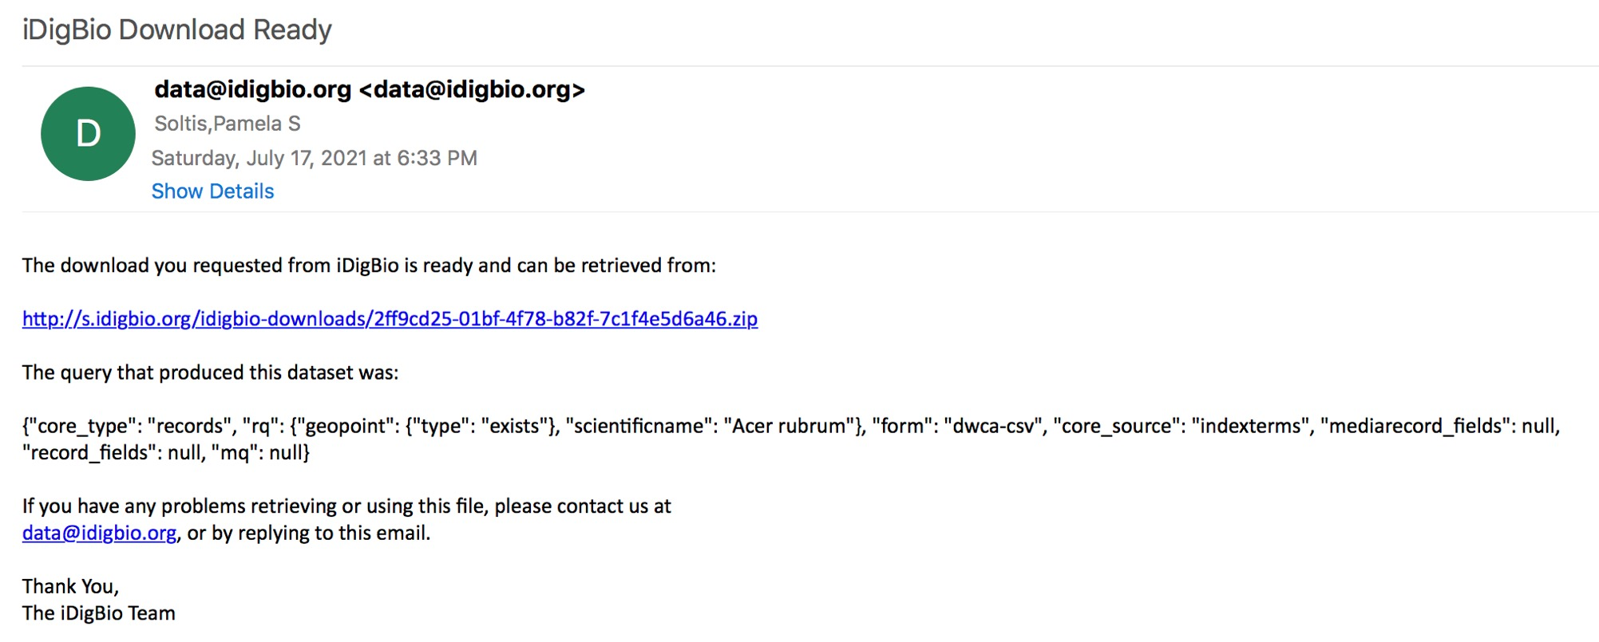
Search the iDigBio Portal: Email Download Link

Slide 15
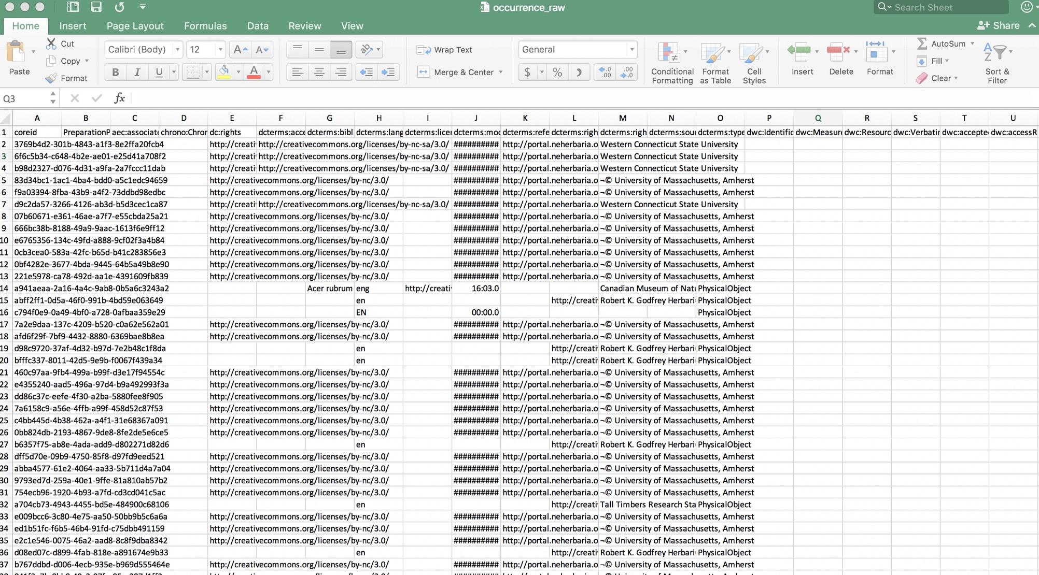
Search the iDigBio Portal

Slide 16
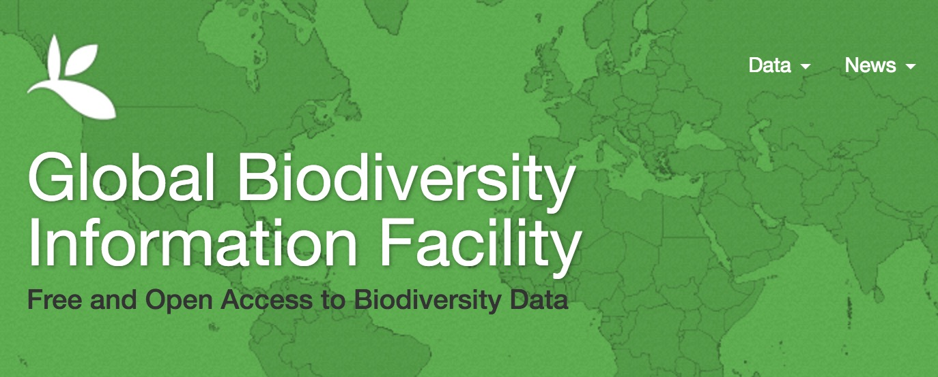
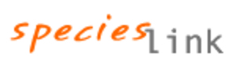
GBIF: gbif.org

Slide 17
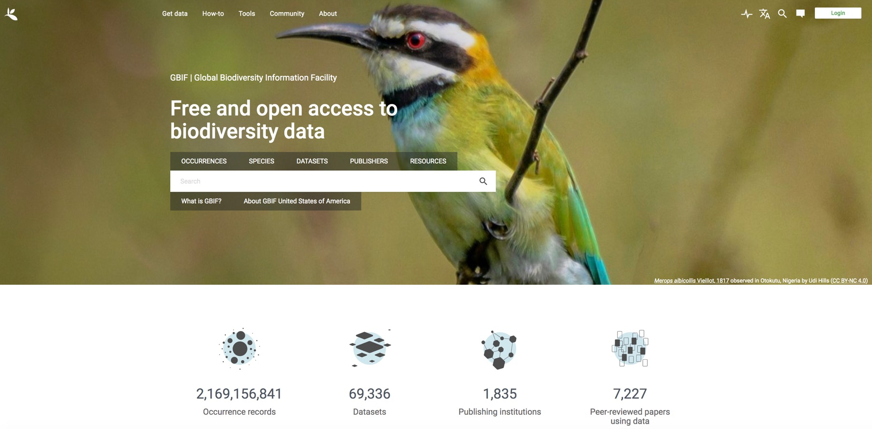
GBIF: gbif.org

Slide 18
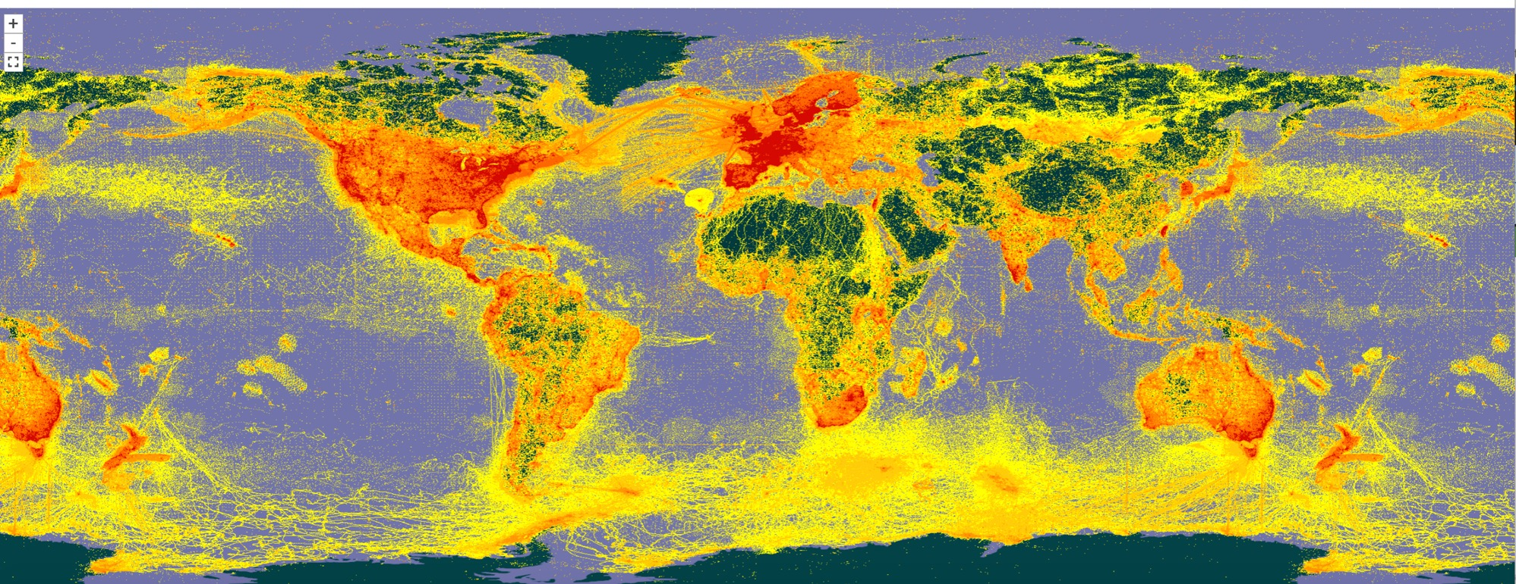
GBIF: gbif.org

Slide 19
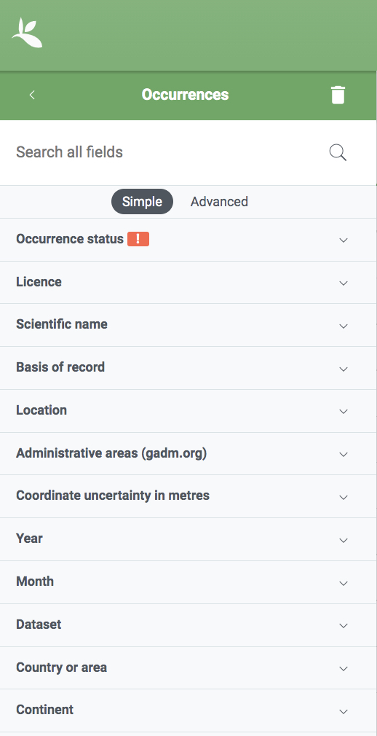
Search GBIF

Slide 20
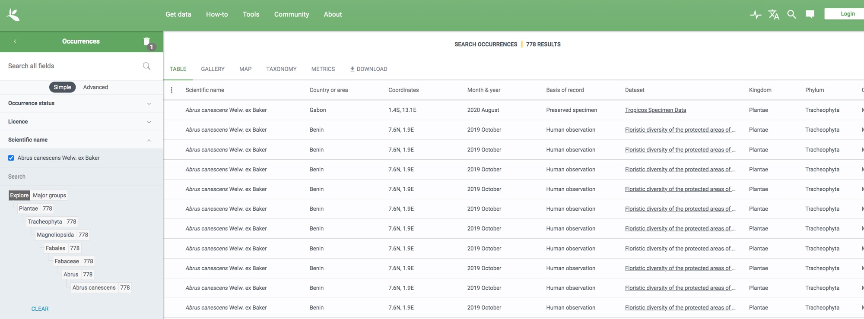
Search GBIF: Abrus canescens

Slide 21
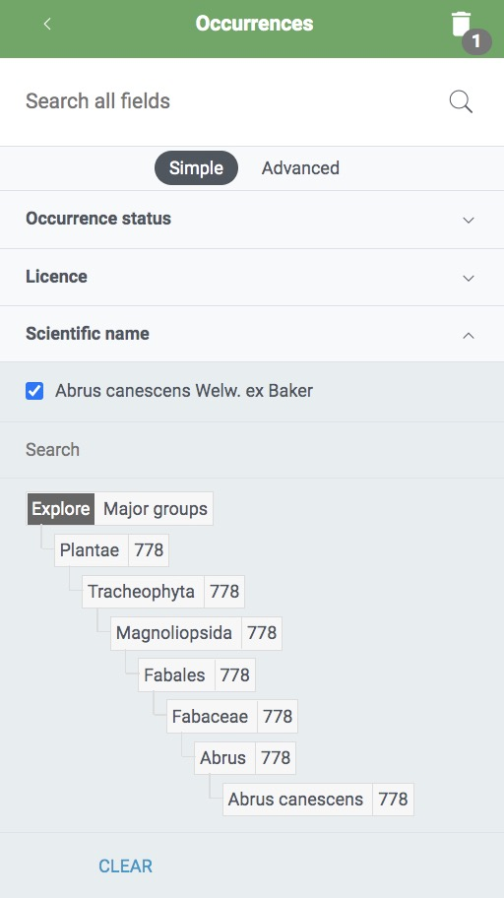
Search GBIF: Abrus canescens

Slide 22
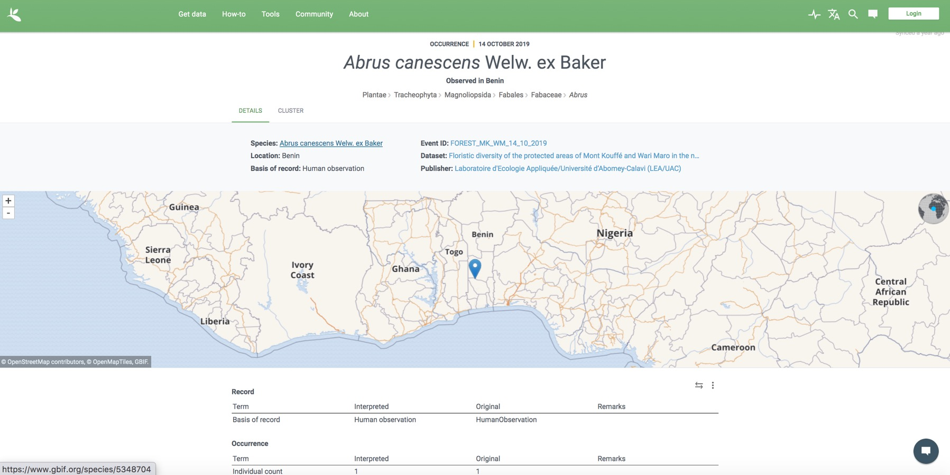
Search GBIF: Abrus canescens

Slide 23
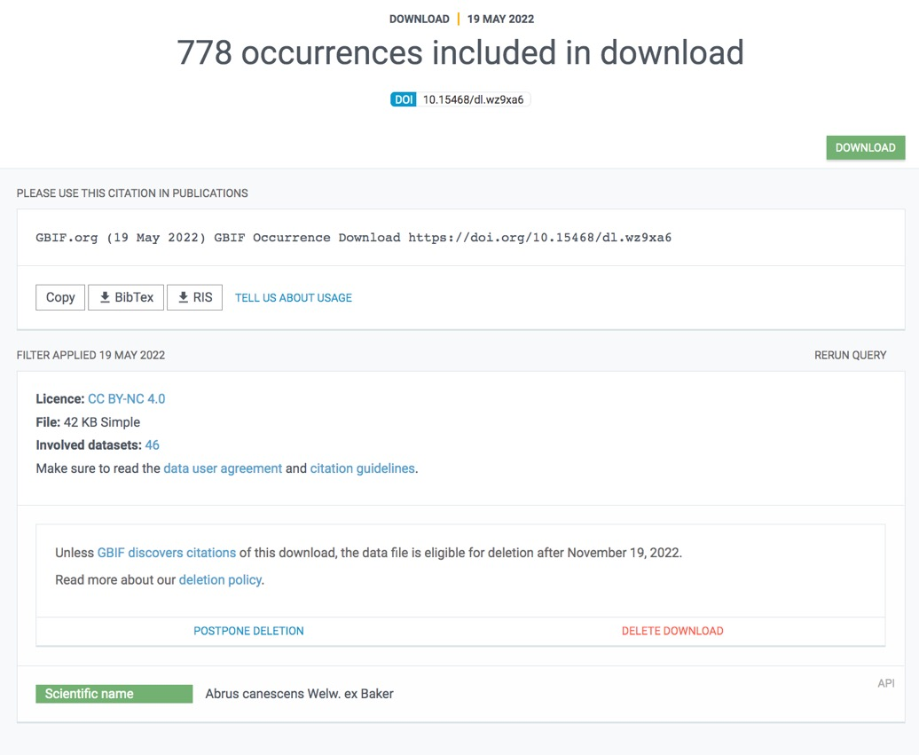
Search GBIF: Download Data Set / Email

Slide 24
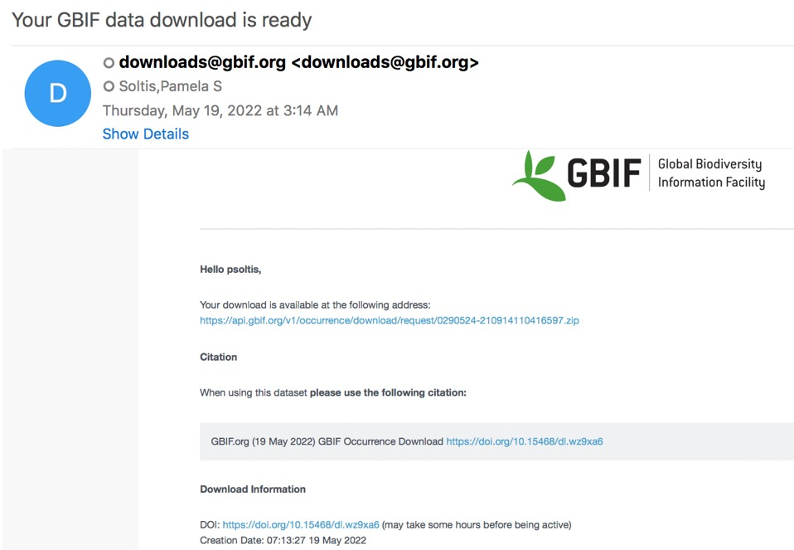
Search GBIF: Download Data Set / Email

Slide 25
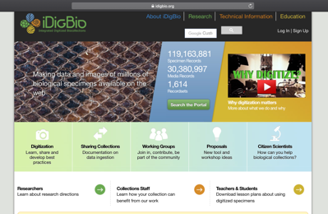

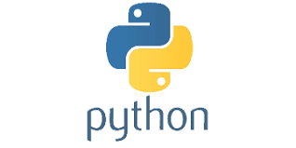
Other Options for Data Downloads
API = Application Programming Interface
Allows users to interact with a system
Web portal
API
Database
Interface

Slide 26
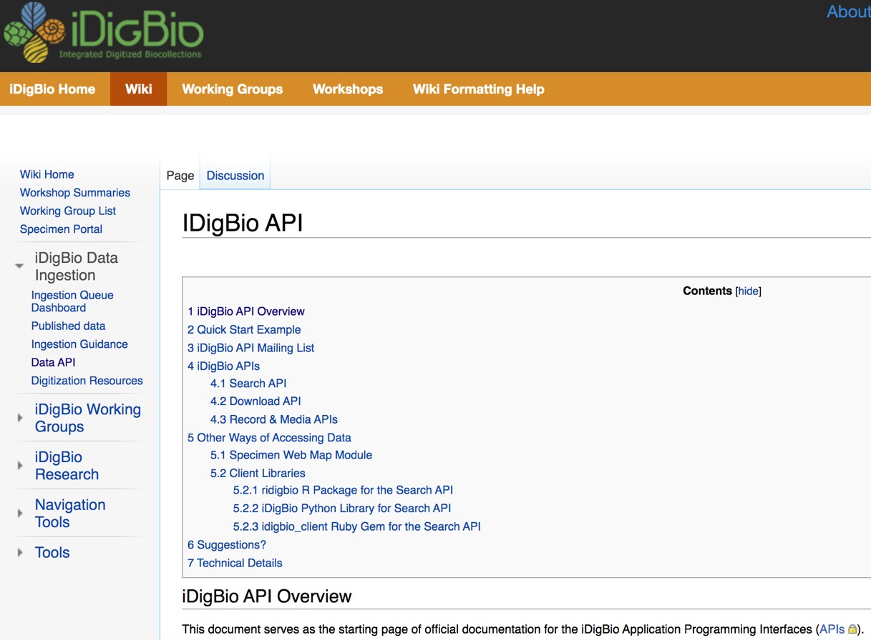
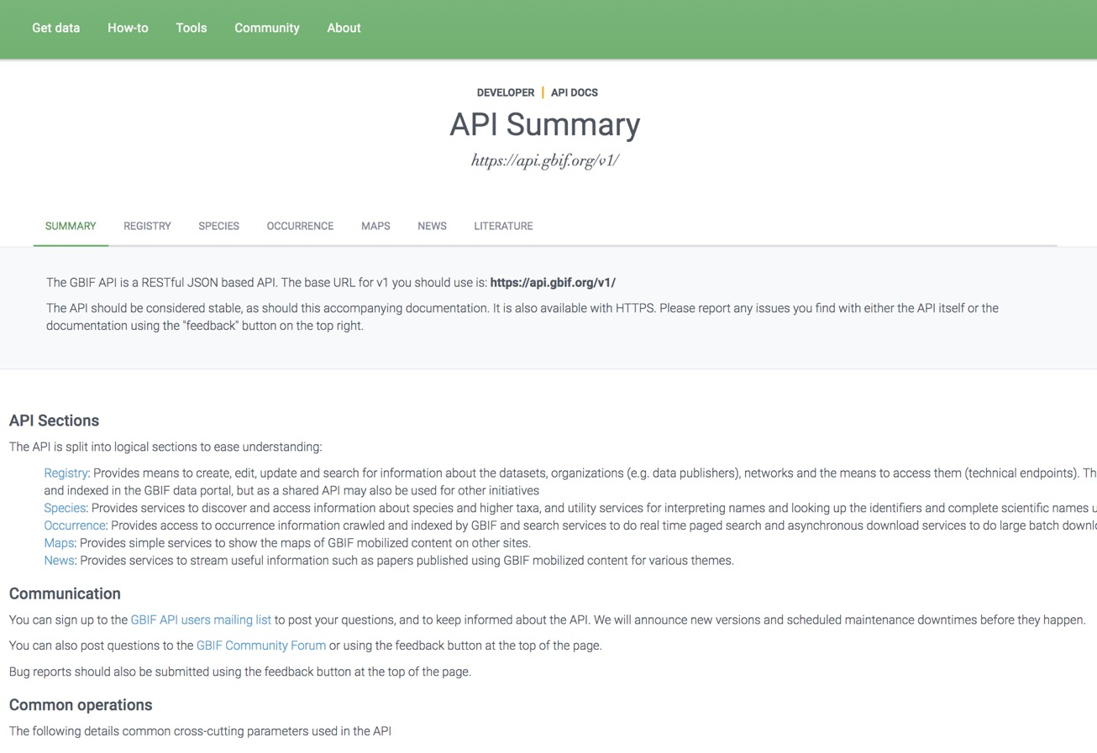
Other Options for Data Downloads: APIs

Slide 27

Other Options for Data Downloads: R packages
ridigbio
rgbif
spocc: Interface to Species Occurrence Data Sources
gatoRs: geographic and taxonomic occurrence R-based scrubbing
Patten et al., APPS, submitted

